Slide 1
Software Configuration Management (SCM)
...... an umbrella activity that is applied throughout the software process. Because changes can occur at any time, SCM activities are developed to
(1) identify change
(2) control change
(3) ensure that change is being properly implemented
(4) report change to others who may have an interest
The primary responsibility is the control of change

Slide 2
SCM Vs. Software maintenance
Maintenance is a set of SE activities that occur after software has been delivered to the customer and put into operation
SCM is a set of tracking and control activities that begin when a software project begins and terminate only when the software is taken out of operation

Slide 3
What is Software Configuration?
Items (such as programs, documents and data) that comprise of all information produced as part of the S/W process are collectively called a Software Configuration
As the software process progresses, the number of software configuration items (SCIs) grows rapidly

Slide 4
The Software Configuration
programs
documents
The pieces
data

Slide 5
Baseline
… an SCM concept that helps us to control change without seriously impeding justifiable change
… a milestone in the development of software that is marked by
  the delivery of one or more SCIs and
  the approval of these SCIs that is obtained through an FTR

Slide 6
IEEE Definition for ‘Baseline’
…a specification or product that has been formally reviewed and agreed upon
that thereafter serves as the basis for further development
that can be changed only through formal change control procedures

Slide 7
Baselines
Steps in S/W process | Baseline defined at this level
System Engineering | System specification
Requirements Analysis | S/W requirements specification
Software design | Design specification
Coding | Source code
Testing | Test plans/procedures/data
Release | Operational system

Slide 8
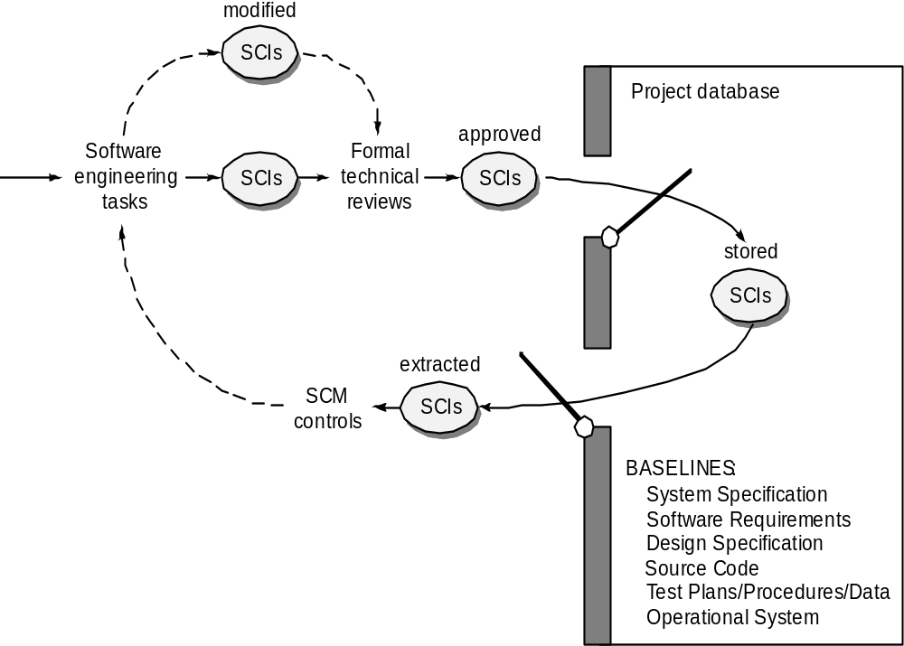
Baselines

Slide 9
What is a configuration item?
An SCI is an aggregation of software that is designated for
configuration management and treated as a single entity in the SCM process
An SCI is a document ,an entire suite of test cases , or a named program component.
Plans, Specification and design documentation
Testing materials
Software tools
Source and executable code and Code libraries
Data and data dictionaries
Documentation for installation, maintenance, operations and software use

Slide 10
Configuration objects
A configuration object has a name, attributes and is ‘connected’ to other objects by relationships
  Basic object
  Aggregate object
  Compositional relationship (curved arrow)
  Inter-relationship (double-headed straight arrow)

Slide 11
Identification of objects in the software configuration
2 types of objects can be identified
  Basic object
    A ‘unit of text’ that has been created by a software engineer during analysis, design, coding or testing
  Aggregate objects
    A collection of basic objects and other aggregate objects (conceptually it can be viewed as a named (identified) list of pointers that specify basic objects)

Slide 12
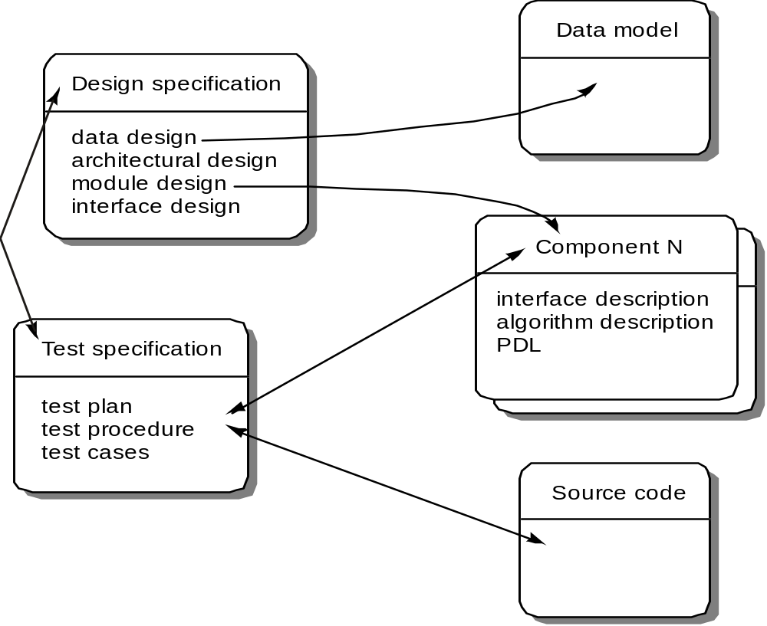
Software Configuration Objects

Slide 13
The SCM process
How does an organization identify and manage the many existing versions of a program in a manner that will enable change to be accommodated efficiently?
How does an organization control changes before and after software is released to a customer?
Who has responsibility for approving and prioritizing changes?
How can we assure that changes have been made properly?
What mechanism is used to appraise others of changes that are made?
… these questions lead to the definition of 5 SCM tasks

Slide 14
5 SCM tasks
Identification
Version control
Change control
Configuration auditing
Status reporting

Slide 15

The SCM Process

Slide 16
Version Control
Combines procedures and tools to manage the different versions of configuration objects created during the software process
An entity is composed of objects at the same revision level
A variant is a different set of objects at the same revision level and coexists with other variants
A new version is defined when major changes have been made to one or more objects

Slide 17
Version Control
A version control system is directly integrated with four major capabilities:
  a project database (repository) that stores all relevant configuration objects
  a version management capability that stores all versions of a configuration object
  a make facility that enables the software engineer to collect all relevant configuration objects and construct a specific version of the software.
  an issues tracking (also called bug tracking) capability that enables the team to record and track the status of all outstanding issues associated with each configuration object.

Slide 18
Change Control
Change request
  submitted and evaluated to assess technical merit and impact on the other configuration objects and budget
Change report
  contains the results of the evaluation
Change control authority (CCA)
  makes the final decision on the status and priority of the change based on the change report

Slide 19
Change Control
Engineering change order (ECO)
  generated for each change approved (describes change, lists the constraints, and criteria for review and audit)
Object to be changed is checked-out of the project database subject to access control parameters for the object
Modified object is subjected to appropriate SQA and testing procedures

Slide 20
Change Control
Modified object is checked-in to the project database and version control mechanisms are used to create the next version of the software
Synchronization control
  used to ensure that parallel changes made by different people don’t overwrite one another

Slide 21
Change Control Process—I
need for change is recognized
change request from user
developer evaluates
change report is generated
change control authority (CCA) decides
request is queued for action,
Engg. Change Order (ECO)
is generated
change request is denied
user is informed
change control process—II

Slide 22
Change Control Process-II
assign people to SCIs
check-out SCIs
make the change
review/audit the change
Check-in SCIs that have been changed
establish a “baseline” for testing
change control process—III

Slide 23
Change Control Process-III
perform SQA and testing activities
Promote changes for inclusion in next release
rebuild appropriate version of software
review/audit the change to all configuration items
include changes in new version (release)
Distribute new version

